Slide 1

Erlang:
It's Pretty Great

Slide 2

What it is
Functional (of course)

Slide 3
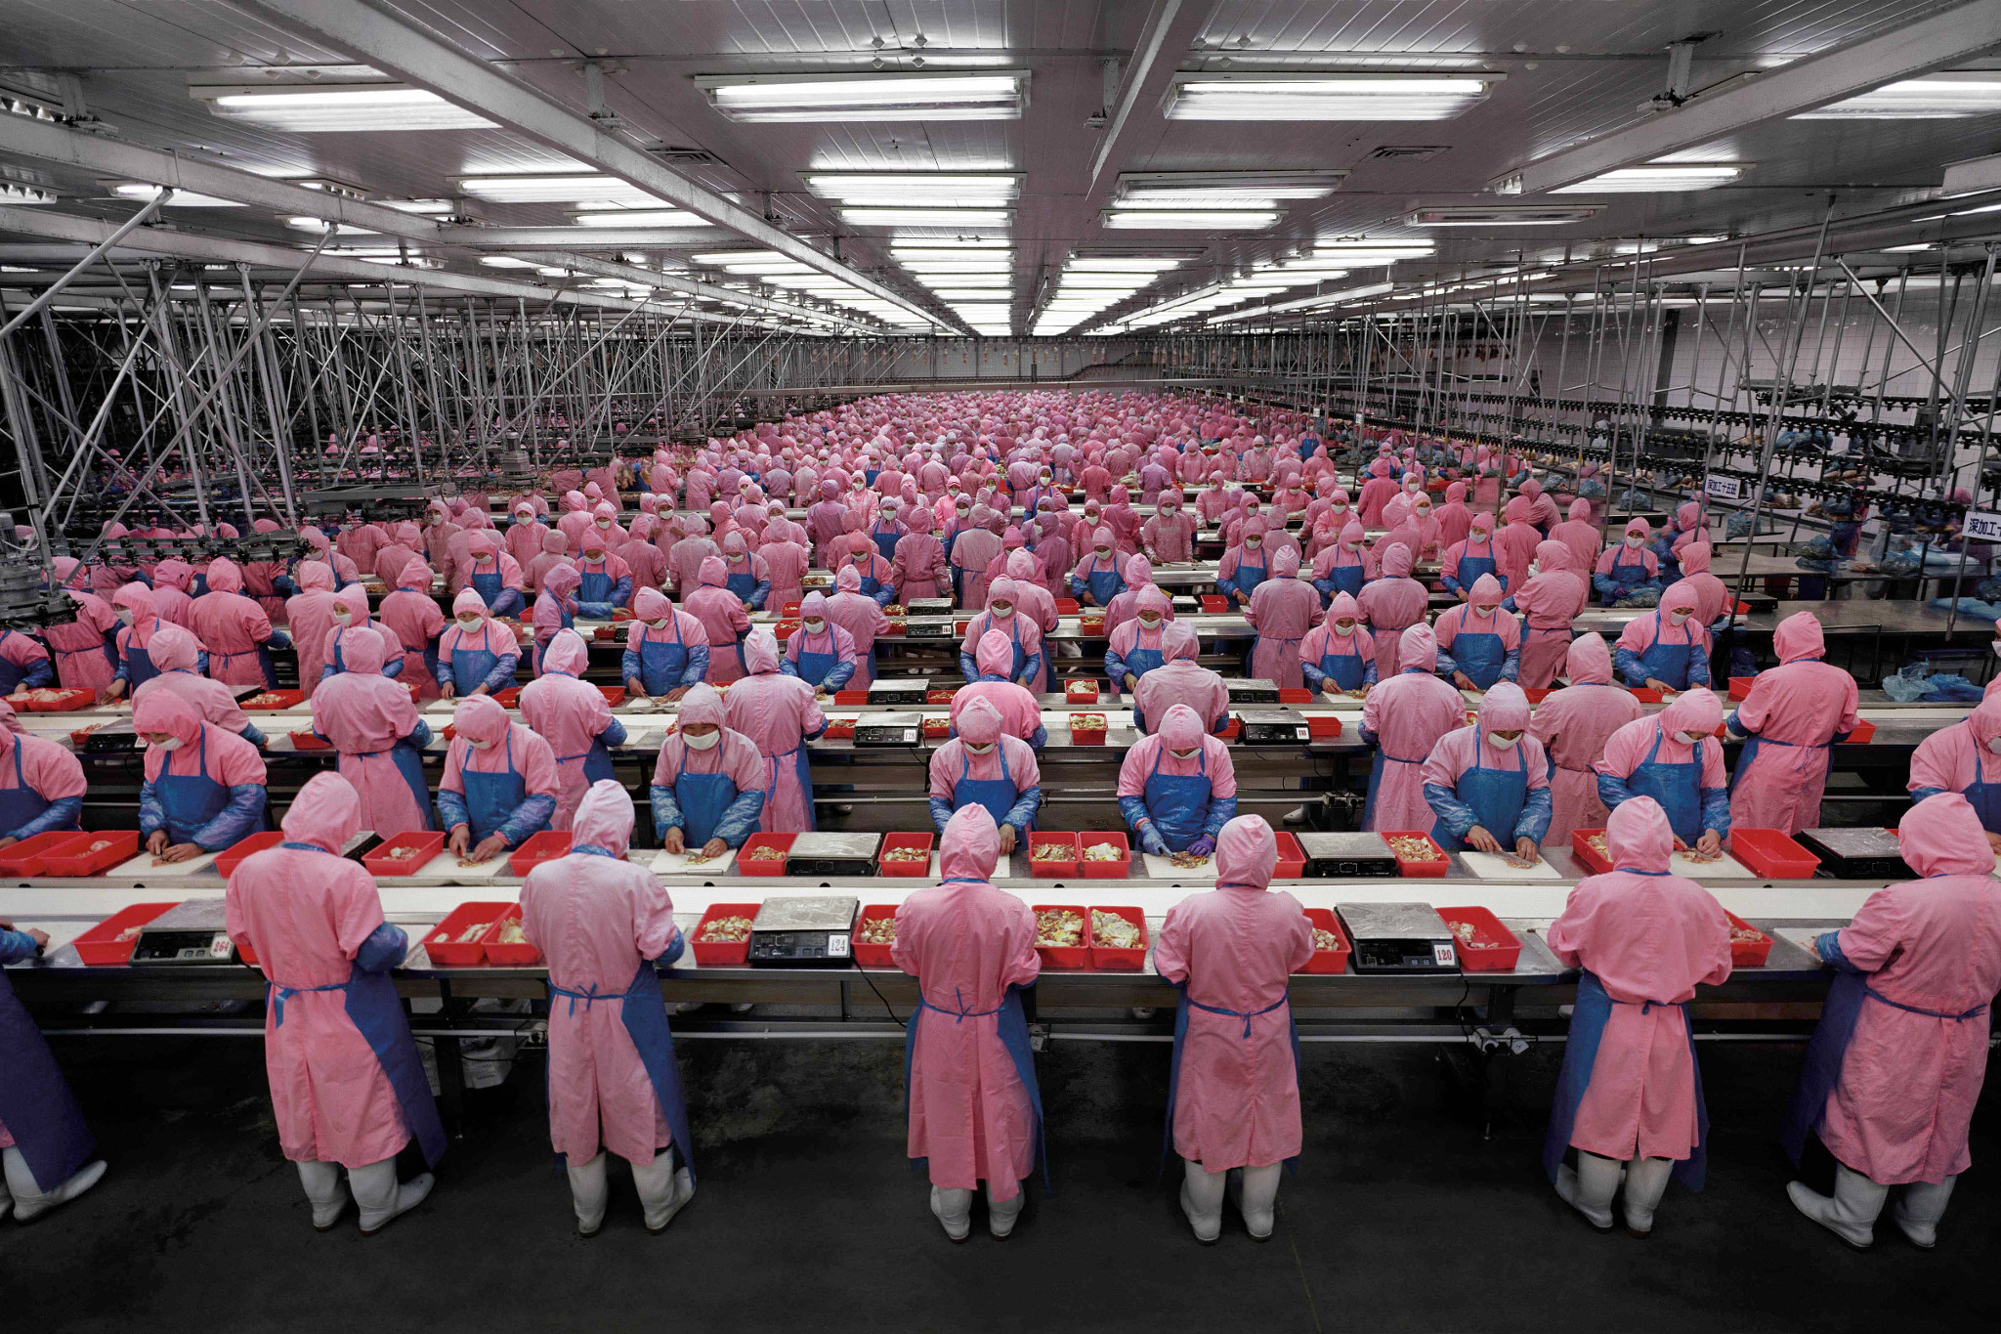
What (else) it is
Highly Concurrent
https://lottiebphotography.files.wordpress.com/2013/10/manufacturedlandscapes-photo02.jpg

Slide 4
What (else else) it is
Fault Tolerant

Slide 5
Also
Dynamically Typed
Share-nothing
Actor model

Slide 6
What it's Not
Pure, Lazy

Slide 7
What it's (also) Not
High Performance (kinda)

Slide 8
Where did it Come From?
Ericsson
First experiments in early 80's
First internal release in 1987
Open Source release in 1998

Slide 9
What does it look like?
-module(quicksort).
-export([qsort/1]).
qsort([]) -> [];
qsort([Pivot|Rest]) ->
qsort([ X || X <- Rest, X < Pivot])
++ [Pivot]
++ qsort([ Y || Y <- Rest, Y >= Pivot]).

Slide 10
Primitive Types
Integer 1
Float 1.0
List [1, 2, a, b, {c, d}]
Tuple {1, 2, [a, b, c]}
Atom hello
Binary <<1, 2, 3, 4>>
Reference #Ref<0.0.0.66>
Fun fun(A) -> A * A end
Pid <0.56.0>
Map (R17+) #{“type” => “dog”, “name” => “Mr Barky”}
Port #Port<1.2.3>

Slide 11
Not Types
Strings
“abc” =:= [97, 98, 99]
Records
-record(person, {name, editor}).
#person{name = “Bernie”, editor = “Vim”}
=:=
{person, “Bernie”, “Vim”}

Slide 12
Highly Concurrent
Tens of thousands of processes (threads) are no problem
Each only costs you (about) 1236 bytes of memory
Primitives for send/receive:
NewPid = spawn(?MODULE, f, []),
NewPid ! {message, Message}
…
f() ->
receive
{message, M} -> io:fwrite(“~p”, [M])
end.

Slide 13
Fault Tolerance
Crashes are isolated
Language-level semantics for crash detection and recovery
Makes what's impossible in C et al merely difficult

Slide 14
Dynamically Typed
Variables and functions do not have explicit type data
Makes coding and refactoring much easier
Makes making type mistakes much easier
Static analysis with Dyalizer eases the pain

